Slide 1
ITR Extraction
A Presentation by Visaj Nirav Shah

Slide 2
Task and Goal
Use Machine Learning to extract entities from Income Tax Return documents.
There are 15 entities to be extracted from a document.
Build an optimal model to accomplish the task.

Slide 3
Approaches
Approach 1 (Stale)
Use existing Python libraries/models
Implemented text extraction (OCR) using PyTesseract, EasyOCR
Use weak supervision techniques like Labelling Functions (spaCy Matcher, Regex, simple logic) to extract entities from the generated text
Approach 2
Use annotations to train a custom model
Annotated the files provided using Roboflow
Trained a custom model using YOLOv5
Extracted text from the predicted bounding boxes using PyTesseract

Slide 4
Tech Stack
Roboflow: Annotate dataset, Preprocessing, Augmentations
YOLOv5, Jupyter Notebook: Train a custom model
OpenCV: Computer Vision library to read images, add bounding boxes and labels
PyTesseract: OCR on bounding boxes
PIL, torch, pdf2jpg, json, os, Pandas, NumPy: Python libraries for various tasks

Slide 5
Annotations, Preprocessing, Augmentations
Create 15 classes, then annotate the given dataset
1 class for each entity to be extracted
Preprocessing
Auto-orient - standardize pixel ordering
Resize - resize the dataset images to 1400 x 1400
Larger images allow for better predictions and reading
Augmentations
90 degree rotate
Brightness - [-25%, 25%]
Noise - [0%, 2%]
Outputs per training example = 3

Slide 6
YOLOv5
YOLO (You Only Look Once) is a Machine Learning algorithm used for object detection in images.
The latest version of YOLO in use right now is YOLOv5, which is also used here.
Model configuration
Dataset
Training - 57 images (80%)
Validation - 6 images (10%)
Testing - 7 images (10%)
Weights: YOLOv5.x
Batch Size: 16
Epochs: 150
Save best.pt (best model weights) for future use

Slide 7
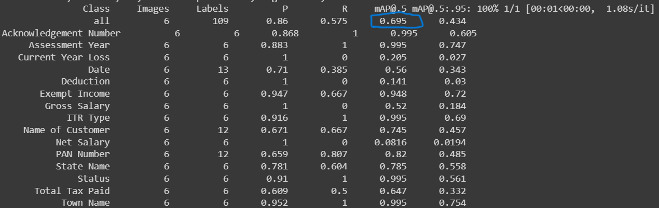
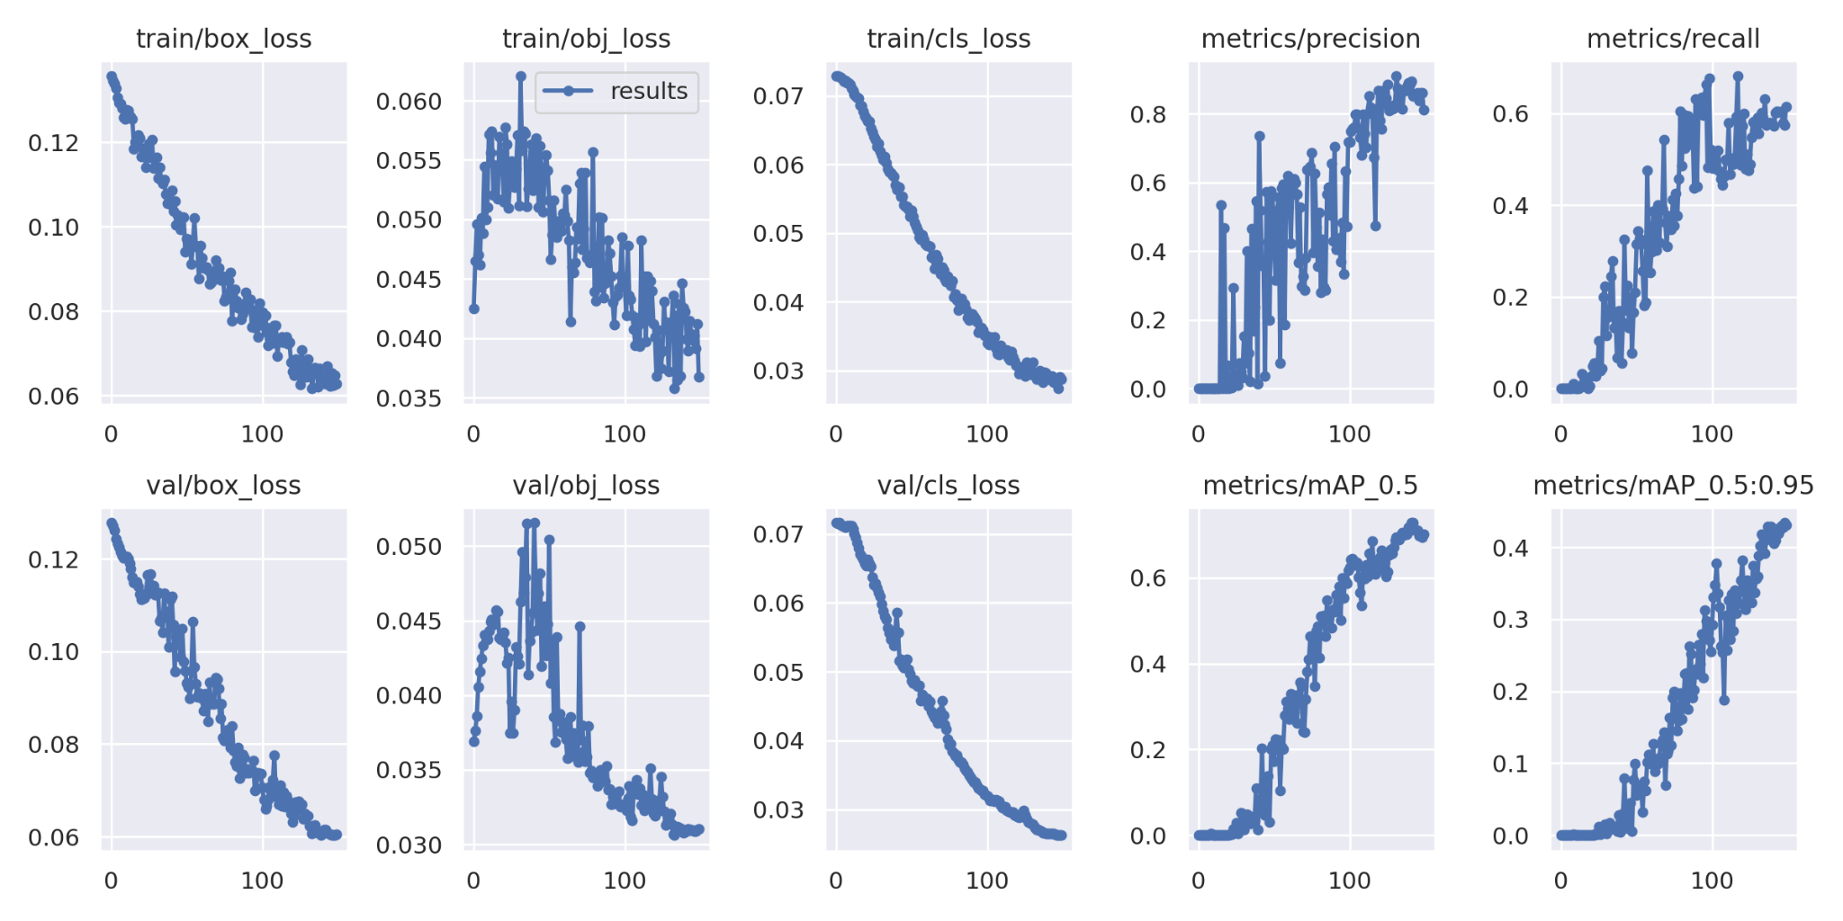

Slide 8
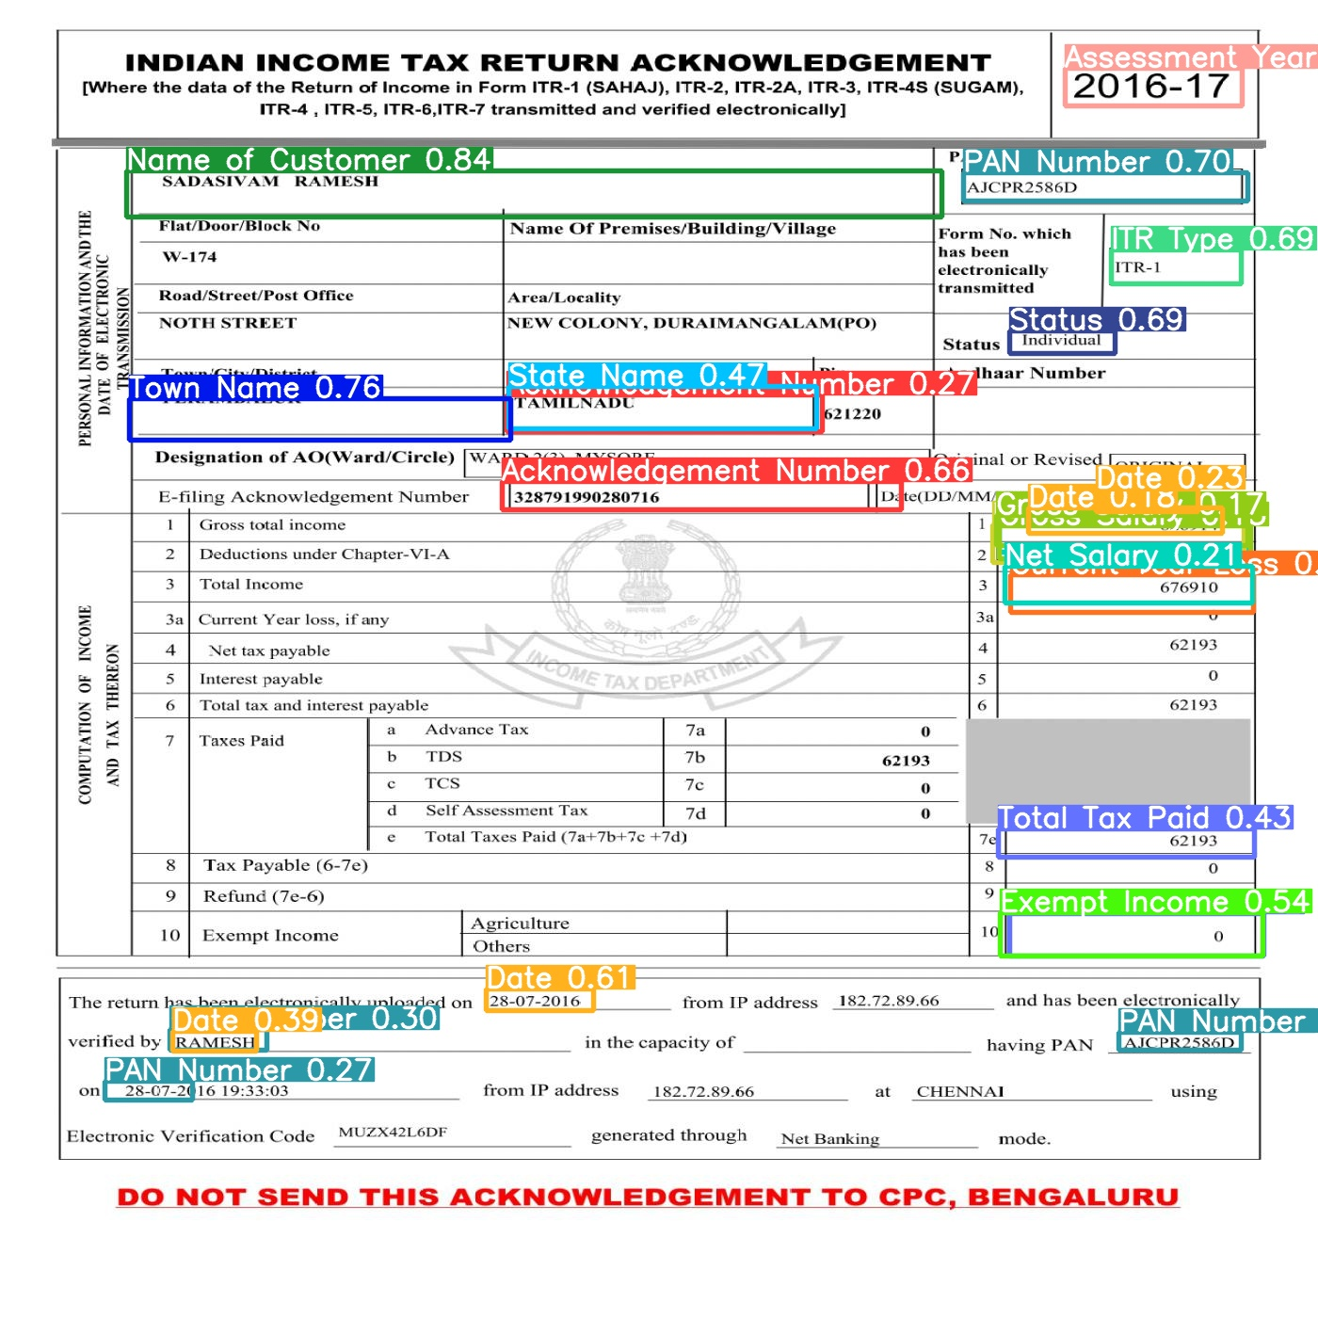
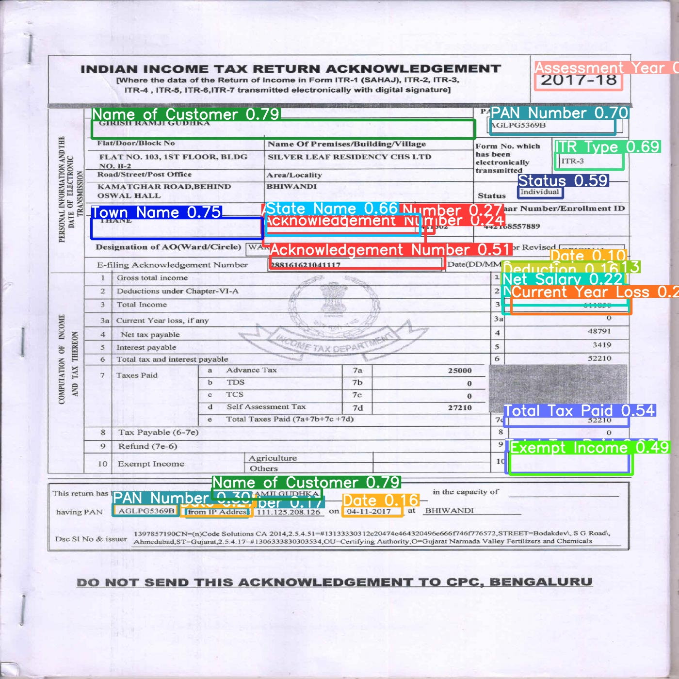

Slide 9
File Processing
First of all, each file is checked for valid file format/extension.
valid_extension_lists = ["jpg", "jpeg", "png", "tif", "pdf"]
If “pdf”: convert to jpg using pdf2jpg
In case of multi-page PDF, each page is treated as an ITR and stored independently
If “tif”: convert to jpg using OpenCV (cv2)
Pass the image through the trained model (read using cv2)
For each class, we select the bounding box with the highest confidence value.
Read the selected bounding box (RoI) using PyTesseract, and save the output in a dictionary.
Add all the selected bounding boxes to the image and store it.
Export the dictionary to JSON (using json).
Keep adding the dictionary of each file to a DataFrame.
At the end, export this DataFrame to Excel/CSV to see a combined output of all files.

Slide 10
DEMO

Slide 11
Possible Improvements
Work on improving the extracted entities
Cleaning
Increase the size of the dataset
With a larger dataset, we can obtain a much better trained model
Run training for more epochs
Using more sophisticated compute resources, we can train the model for more epochs.
According to YOLOv5, more than 3000 epochs are common.
Explore even more techniques and models like Resnet, Faster R-CNN

